Slide 1
Basic Soils

Slide 2
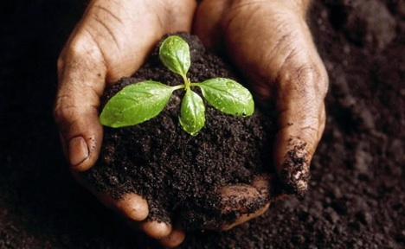
What is Soil?
Comprised of solids (minerals and organic matter), liquid, and gases.
Occupies space and occurs on the land surface.

Slide 3
Why is soil so important to our lives?
Sustains plant and animal life below and above the surface.
Providing support to structures.
Storing and cycling nutrients.
Regulating and partitioning water and solute flow.
Filtering ground water.

Slide 4
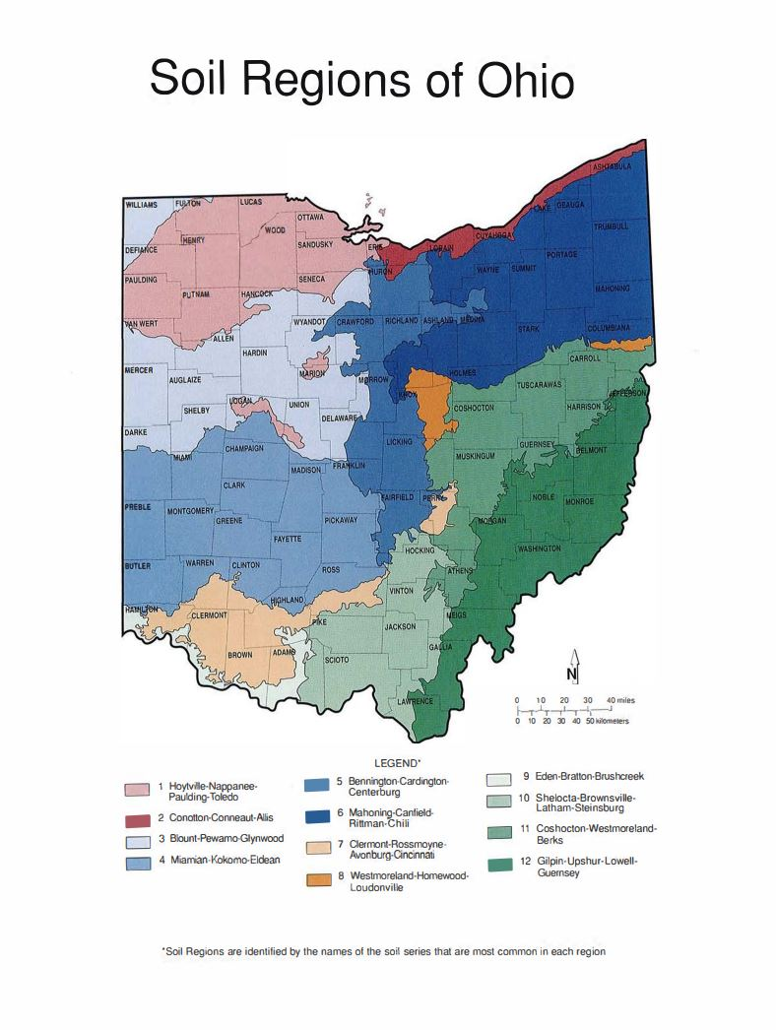
Soil varies across the landscape.
Soils are dived by regions and class.
12 different soil regions in Ohio
Lawrence County is split by two different soil regions

Slide 5
4 Basic Processes of Soil Formation
Additions
Losses
Translocations
Transformations

Slide 6
5 Soil Forming Factors
Climate
Living Organisms
Relief (Topography)
Parent Material
Time

Slide 7
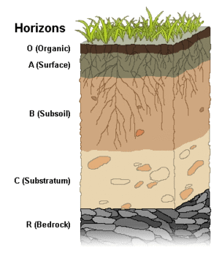
Soil Horizon

Slide 8
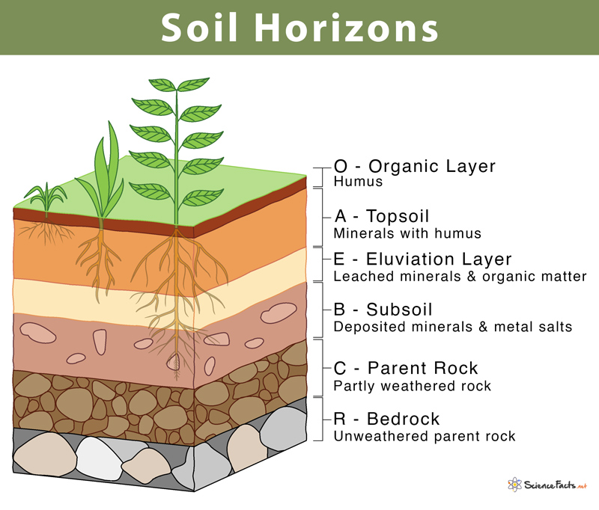

Slide 9
Soil Texture
Soil texture refers to the proportion of sand, silt and clay sized particles that make up the mineral fraction of the soil.
Texture is important because it influences:
the amount of water the soil can hold
the rate of water movement through the soil
how workable and fertile the soil is.

Slide 10
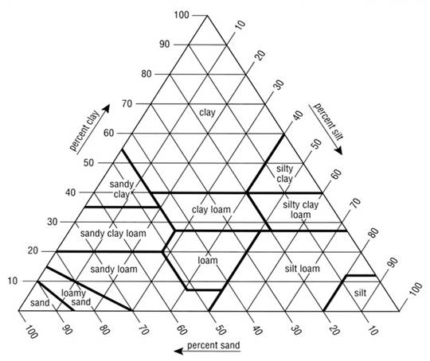
Soil Texture Triangle

Slide 11
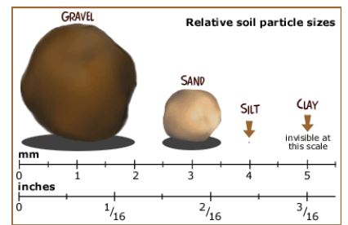
Soil Particles

Slide 12
Soil Nutrients
N – P – K
Ca – Mg – S

